Slide 1
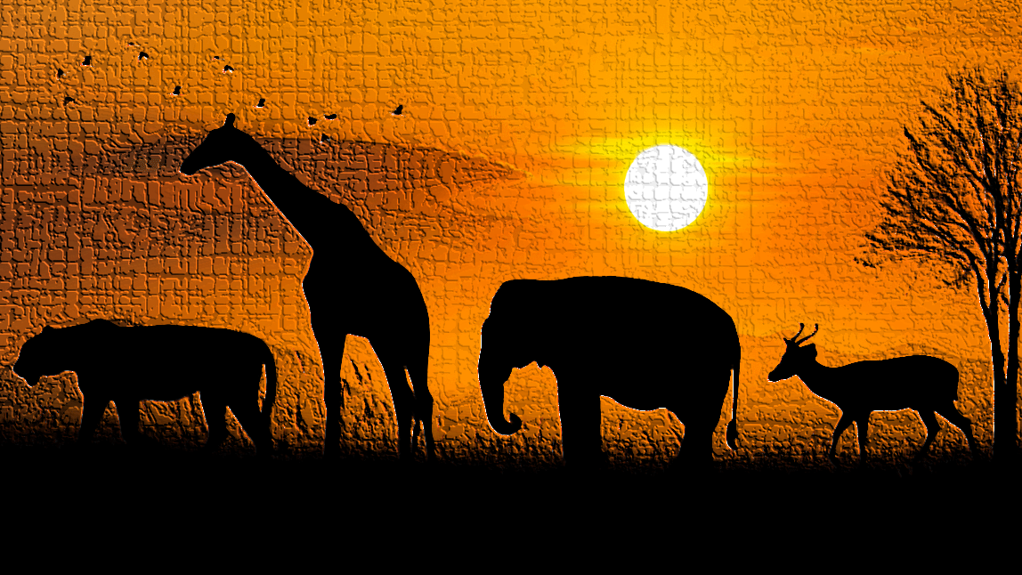
Animal Classification
AI Model to identify animals
Internship ID: UMIP272882 Name: Yashwanth Reddy Kuchipudi

Slide 2
Dataset Description
The dataset contains 15 folders of images of dimensions: 224 x 224 x 3, suitable for image classification.
Classes in the dataset:
Bear, Bird, Cat, Cow, Deer, Dog, Dolphin, Elephant, Giraffe, Horse, Kangaroo, Lion, Panda, Tiger, Zebra

Slide 3
Approach
Exploration of dataset
Training and Validation data generators
MobileNetV2 Model implementation
Fine-tuning
Test Results
Results visualization
Model testing on random animal images

Slide 4
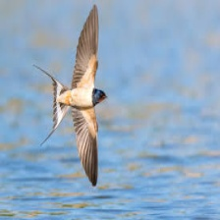
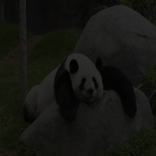
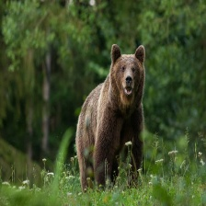
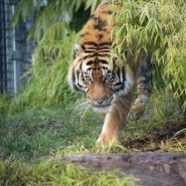
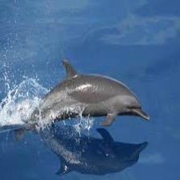
Exploration of dataset
Images of various animal under different light conditions, angles and quality were present in the dataset. Some of the images from the dataset were shown below:

Slide 5
Training and Validation data generators
ImageDataGenerators were used to rescaling and augmenting images for training, validation and testing of the model.
Training data images – 1516
Validation data images - 383
MobileNetV2 Model (Transfer Learning)
MobileNetV2 is used as a base model with pre-trained ImageNet weights, freezing the convolutional base initially
dense layers were added for classifying 15 animal classes.
Adam optimizer was used with a smaller learning rate of 0.001 for better results

Slide 6
Training & Validation Accuracy
The accuracy of the model after 20 epochs are:
Training Accuracy – 93.72
Validation Accuracy – 83.80

Slide 7
Fine-Tuning the Model
Some of the layers were unfreezed from the base model after initial training for better accuracy.
Learning rate 1e^-5, Cross_Entropy loss, and 10 epochs were chosen for the model fine-tuning.
Accuracy values after Fine-Tuning the model are:
Training Accuracy – 93.52
Validation Accuracy – 84.09

Slide 8
Results on Test Data
Test data images generated are 1944
Test accuracy – 97.50
Test Loss – 0.084
The results were impressive on the test data with higher accuracy ad lower loss.

Slide 9
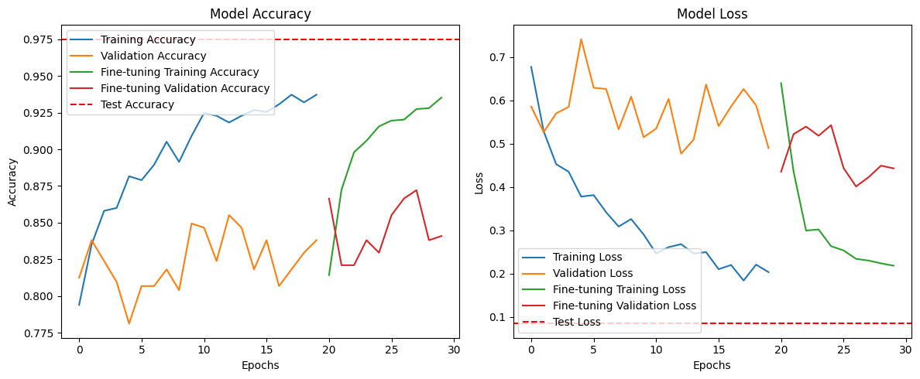
Results Visualization

Slide 10
Results and Observation
Training and Validation Accuracy:
The initial training phase shows a steady increase in both training and validation accuracy. Validation accuracy plateaus around 84% by the end of the initial training, indicating the model is learning but may have reached its limit with frozen layers.
Fine-tuning improves training accuracy further, pushing it close to 93%. Validation accuracy also slightly increases, though with some fluctuations, suggesting sensitivity to small adjustments.
Test Accuracy:
The final test accuracy reaches an impressive 97.5%, surpassing both training and validation accuracies. This indicates that the model generalizes well to unseen data, though the gap suggests a slight possibility of overfitting during fine-tuning.
Loss Curves:
Training loss consistently decreases during both phases, reflecting the model’s ability to minimize errors. Validation loss, however, fluctuates more, especially during fine-tuning, which could hint at minor overfitting or variance issues.

Slide 11
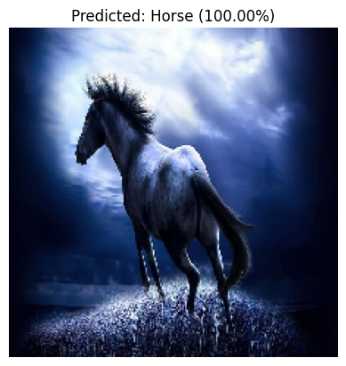
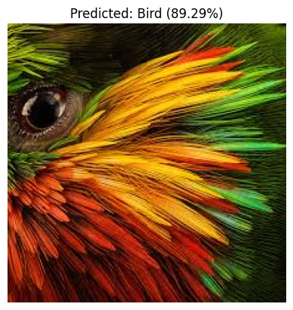
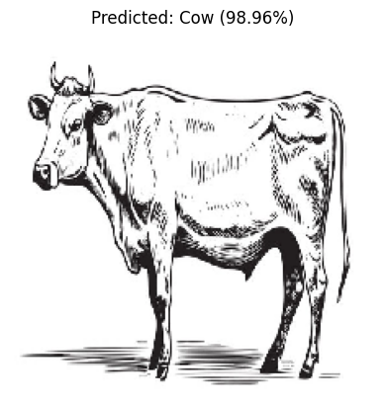
Model testing on random animal images

